Slide 1

PHILIPPINE BUS ASSISTANCE
TRACKING
BUY TICKETS
HELP

Slide 2


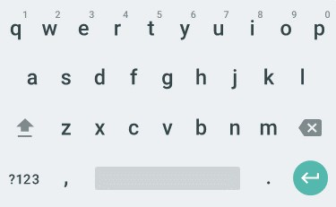
Search
BBL BUS TERMINAL – BUENDIA
BBL BUS TERMINAL – SAN PEDRO
DLTB BUS TERMINAL
….. Or pinpoint exact location

Slide 3
Search
BBL BUS TERMINAL – BUENDIA
BBL BUS TERMINAL – SAN PEDRO
DLTB BUS TERMINAL
….. Or pinpoint exact location

Slide 4


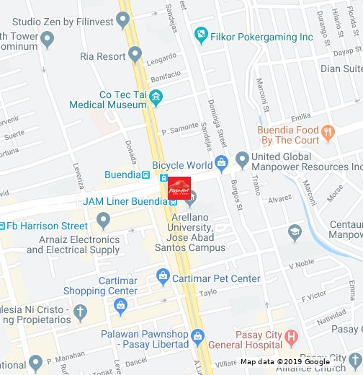
PIN POINT - TRACKING

Slide 5
PIN POINT – BUY TICKETS

Slide 6






PIN POINT - TRACKING
PBA
HOME
TRACKING
BUY
TICKETS
HELP
BACK

Slide 7


PBA
PIN POINT – BUY TICKETS
HOME
TRACKING
BUY
TICKETS
HELP
BACK

Slide 8
PBA
Search
BBL BUS TERMINAL – BUENDIA
BBL BUS TERMINAL – SAN PEDRO
DLTB BUS TERMINAL
….. Or pinpoint exact location
HOME
TRACKING
BUY
TICKETS
HELP
BACK

Slide 9
PBA
Search
BBL BUS TERMINAL – BUENDIA
BBL BUS TERMINAL – SAN PEDRO
DLTB BUS TERMINAL
….. Or pinpoint exact location
HOME
TRACKING
BUY
TICKETS
HELP
BACK

Slide 10
TRACKING
BBL BUS TERMINAL BUENDIA
BUSES | STATUS | ETA
To Pacita via Susana Heights – San Pedro | ARRIVED | -----
To Southwoods |  | 1:00 pm to 2:00 PM
To Balibago | Arriving | 12:30pm

Slide 11
BUY TICKETS
BBL BUS TERMINAL BUENDIA
BUSES | STATUS | ETA
To Pacita via Susana Heights – San Pedro | ARRIVED | -----
To Southwoods |  | 1:00 pm to 2:00 PM
To Balibago | Arriving | 12:30pm

Slide 12
TRACKING
PBA
BBL BUS TERMINAL BUENDIA
HOME
BUSES | STATUS | ETA
To Pacita via Susana Heights – San Pedro | ARRIVED | -----
To Southwoods |  | 1:00 pm to 2:00 PM
To Balibago | Arriving | 12:30pm
TRACKING
BUY
TICKETS
HELP
BACK

Slide 13
TRACKING
PBA
BBL BUS TERMINAL BUENDIA
HOME
BUSES | STATUS | ETA
To Pacita via Susana Heights – San Pedro | ARRIVED | -----
To Southwoods |  | 1:00 pm to 2:00 PM
To Balibago | Arriving | 12:30pm
TRACKING
BUY
TICKETS
HELP
BACK

Slide 14
BUS ARRIVAL (LOCATION)
TO BALIBAGO
BUY TICKETS

Slide 15
BUS ARRIVAL (LOCATION)
PBA
TO BALIBAGO
HOME
TRACKING
BUY
TICKETS
HELP
BACK

Slide 16


BUY TICKETS
GENERATE QR CODE

Slide 17
TRACKING
PBA
GENERATE QR CODE
HOME
TRACKING
BUY
TICKETS
HELP
BACK

Slide 18
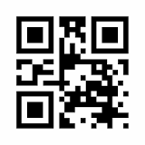
GENERATE QR CODE
TO BALIBAGO
PRICE: 46 PHP
INSTRUCTIONS:
Present the QR Code to the bus personnel for scanning
Give the Appropriate Fee
Wait for the SMS that will serve as your receipt and proof of purchase

Slide 19

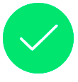
GENERATE QR CODE
TO BALIBAGO
PRICE: 46 PHP
PAYMENT SUCCESSFUL
INSTRUCTIONS:
Present the QR Code to the bus personnel for scanning
Give the Appropriate Fee
Wait for the SMS that will serve as your receipt and proof of purchase

Slide 20
GENERATE QR CODE
PBA
TO BALIBAGO
PRICE: 46 PHP
HOME
TRACKING
INSTRUCTIONS:
Present the QR Code to the bus personnel for scanning
Give the Appropriate Fee
Wait for the SMS that will serve as your receipt and proof of purchase
BUY
TICKETS
HELP
BACK

Slide 21
PAYMAYA PAYMENT
PRICE: 46 PHP
FUND SOURCE
Paymaya – 500.04
RECIPIENT
BUS: BBL (To Southwoods)
Account Number
**** **** **** ****
CONTINUE

Slide 22
PAYMAYA PAYMENT
PBA
PRICE: 46 PHP
FUND SOURCE
Paymaya – 500.04
RECIPIENT
BUS: BBL (To Southwoods)
Account Number
**** **** **** ****
HOME
TRACKING
BUY
TICKETS
HELP
CONTINUE
BACK

Slide 23
GCASH PAYMENT
PRICE: 46 PHP
FUND SOURCE
GCASH – 500.04
RECIPIENT
BUS: BBL (To Southwoods)
Account Number
**** **** **** ****
CONTINUE

Slide 24
PAYMAYA PAYMENT
PBA
PRICE: 46 PHP
FUND SOURCE
Paymaya – 500.04
RECIPIENT
BUS: BBL (To Southwoods)
Account Number
**** **** **** ****
HOME
TRACKING
BUY
TICKETS
HELP
CONTINUE
BACK

Slide 25
PAYMAYA PAYMENT SUMMARY
BBL
Account number | **** **** **** ****
Amount | PHP 46.00
Date | YYYY-MM-DD, HH:MM
Reference ID | PayMaya 1213212
Receipt Number | 1234567890
CONTINUE

Slide 26
PAYMAYA PAYMENT SUMMARY
PBA
BBL
Account number | **** **** **** ****
Amount | PHP 46.00
Date | YYYY-MM-DD, HH:MM
Refernece ID | PayMaya 1213212
Receipt Number | 1234567890
HOME
TRACKING
BUY
TICKETS
HELP
CONTINUE
BACK

Slide 27
PAYMAYA PAYMENT SUMMARY
BBL
PAYMENT SUCCESSFUL
Account number | **** **** **** ****
Amount | PHP 46.00
Date | YYYY-MM-DD, HH:MM
Reference ID | PayMaya 1213212
Receipt Number | 1234567890
CONTINUE

Slide 28
GCASH PAYMENT SUMMARY
BBL
Account number | **** **** **** ****
Amount | PHP 46.00
Date | YYYY-MM-DD, HH:MM
Reference ID | GCASH 1213212
Receipt Number | 1234567890
CONTINUE

Slide 29
PAYMAYA PAYMENT SUMMARY
PBA
BBL
Account number | **** **** **** ****
Amount | PHP 46.00
Date | YYYY-MM-DD, HH:MM
Refernece ID | GCASH 1213212
Receipt Number | 1234567890
HOME
TRACKING
BUY
TICKETS
HELP
CONTINUE
BACK

Slide 30
GCASH PAYMENT SUMMARY
BBL
PAYMENT SUCCESSFUL
Account number | **** **** **** ****
Amount | PHP 46.00
Date | YYYY-MM-DD, HH:MM
Reference ID | PayMaya 1213212
Receipt Number | 1234567890
CONTINUE

Slide 31
HELP
How do I get to the map view for the bus tracker?
How do I buy Tickets?

Slide 32
HELP
How do I get to the map view for the bus tracker?
You can access by going to TRACKING → SEARCH for your bus terminal/ pinpoint (it would go directly to the closest bus terminal) → CHOOSE bus destinations

Slide 33
HELP
How do I buy Tickets?
Click the BUY TICKETS → SEARCH for your bus terminal/ pinpoint (it would go directly to the closest bus terminal) → CHOOSE bus destinations → CHOOSE payment method.
CHOOSE bus destinations

Slide 34

HELP
PBA
HOME
TRACKING
BUY
TICKETS
HELP
BACK

Slide 35
FEEDBACK
THANK YOU FOR RIDING WITH US!
WE WOULD APPRECIATE YOUR FEEDBACK!
YOU HAVE ANY COMMENTS…
DONE

Slide 36

FEEDBACK
PBA
THANK YOU FOR RIDING WITH US!
WE WOULD APPRECIATE YOUR FEEDBACK!
HOME
TRACKING
BUY
TICKETS
YOU HAVE ANY COMMENTS…
DONE
HELP
BACK

Slide 37
FEEDBACK
THANK YOU FOR RIDING WITH US!
WE WOULD APPRECIATE YOUR FEEDBACK!
YOU HAVE ANY COMMENTS…
DONE

Slide 38
FEEDBACK
THANK YOU FOR RIDING WITH US!
WE WOULD APPRECIATE YOUR FEEDBACK!
YOU HAVE ANY COMMENTS…
DONE

Slide 39
FEEDBACK
THANK YOU FOR RIDING WITH US!
WE WOULD APPRECIATE YOUR FEEDBACK!
YOU HAVE ANY COMMENTS…
DONE

Slide 40
FEEDBACK
THANK YOU FOR RIDING WITH US!
WE WOULD APPRECIATE YOUR FEEDBACK!
YOU HAVE ANY COMMENTS…
DONE

Slide 41
FEEDBACK
THANK YOU FOR RIDING WITH US!
WE WOULD APPRECIATE YOUR FEEDBACK!
YOU HAVE ANY COMMENTS…
DONE

Slide 42
FEEDBACK
YOU HAVE ANY COMMENTS…
DONE

Slide 43
FEEDBACK
YOU HAVE ANY COMMENTS…
THANK YOU FOR YOUR FEEDBACK!
DONE

Slide 44
FEEDBACK
YOU HAVE ANY COMMENTS…
DONE

Slide 45
FEEDBACK
YOU HAVE ANY COMMENTS…
THANK YOU FOR YOUR FEEDBACK!

Slide 46
FEEDBACK
YOU HAVE ANY COMMENTS…
DONE

Slide 47
FEEDBACK
YOU HAVE ANY COMMENTS…
YOU HAVE ANY COMMENTS…
THANK YOU FOR YOUR FEEDBACK!
DONE

Slide 48
FEEDBACK
YOU HAVE ANY COMMENTS…
DONE

Slide 49
FEEDBACK
YOU HAVE ANY COMMENTS…
YOU HAVE ANY COMMENTS…
THANK YOU FOR YOUR FEEDBACK!
DONE

Slide 50
FEEDBACK
YOU HAVE ANY COMMENTS…
DONE

Slide 51
FEEDBACK
YOU HAVE ANY COMMENTS…
YOU HAVE ANY COMMENTS…
THANK YOU FOR YOUR FEEDBACK!
DONE

